Slide 1
Wildfire forecast A geospatial data science project
Sascha Moccozet, Luigi GIANETTI, Quentin Voituron

Slide 2
Content
Context
Literature review
Goal definition
Data Pipeline
Model
Risk map
Conclusion and next step
Bonus: Explanaible AI? Variable importance? Parametric model for simulation

Slide 3
Context
Wildfire are originally a necessary natural process for ecological succession and soil enhancement [1]
BUT according to Promotheus, 8 out 10 are caused by human activities [2]
Both natural conditions and human activities can enhance ignition risk and propagation, to site a few: [2]
Natural
Weather conditions (wind, rain, thunder…)
Soil moisture
Anthropologic
Accident (train, power-line…)
Malicious conduct
Vegetation types
Orographic conditions (flat, steep…)
Negligence (cigarette butt, bbq…)
Forest & farming
Urban sprawl

Slide 4
Context
In any case, it has a powerful destructive power, and it is of paramount importance to work toward risk reduction.
3 main areas of research and application:
Our Focus
Prediction
Detection
Post-fire impact

Slide 5
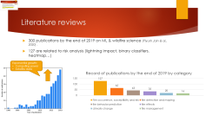
Literature reviews
First risk mapping in 2006 (Piyush Jain & al., 2020). They used CART. Nowadays, ANN and RF are commonly used and give good results compare to linear models. (Goldarag et al. 2016, Oliveira et al. 2012)
When supervised ML, original datasets are highly imbalanced (fire/no fire) and there is no standard along the papers. If no correction, precision and F1 score are close to 0.
Often, models are evaluated on a test/evaluation set. It is interesting from a ML point of view. But for real life application we will use past and present data to predict fire occurrence without any knowledge of some parameters at t+1. (Ioannis Prapas et al. 2021, Fantine Huot et al. 2022)

Slide 6
Goal
In that context we want to create a POC to help firefighters and local collectivities:
RISK map
With a model explainer to gain insight a put in place
Risk will be defined as: probability a specific location will be on fire. From 0 (lowest) to 1(highest)
The Are of Interest will be around the region PACA in France.
Time granulometery will be on day.
Spatial resolution, 1km
The dataset will be balanced 50/50

Slide 7
















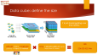


Data pipeline
Data cube building
Model building
Data providers
Raw data
raster & vector
DataFrame
Model
External provider
Remote sensoring data
Terra MODIS
Data cube
External provider
3. Merge
Reanalysis data
Deployment
Copernicus
External provider
Reanalysis data
1. Define the size
Explainable AI
Risk Map
Density dataset
External provider
Vector drawing
Personal drawing
2. Request data

Slide 8

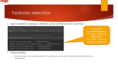
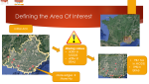
Challenges
#data = 6,102,554,094
Challenge 1: It’s a lot of data
27 features * cube size
Challenge 2: we must care of the data integrity
clipping, projection, downsampling, upsampling, regridding or interpolate… A lot of transformation will be needed
Solution: Explanatory data Analysis + features selection BEFORE merging (here)
And compare afterward

Slide 9
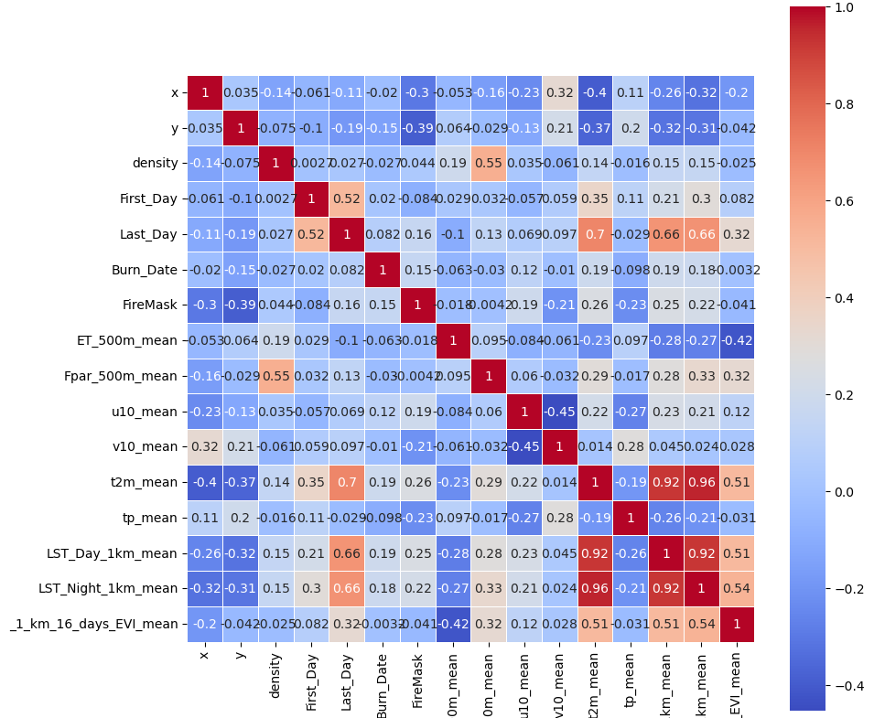
Correlation matrix
Correlation between all the possible pairs in the table
Low correlation between variables
Need to use a more complex model

Slide 10
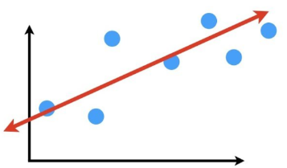
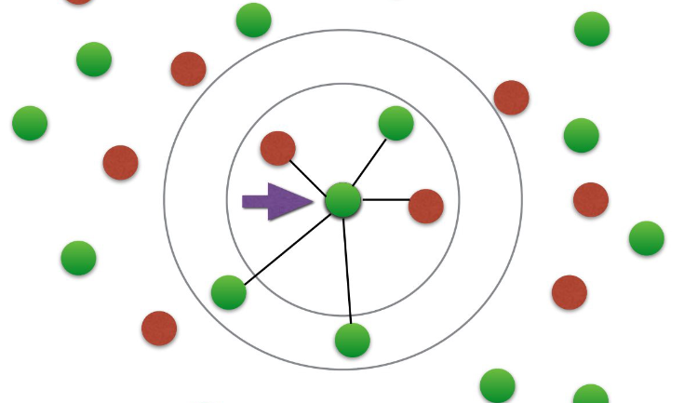
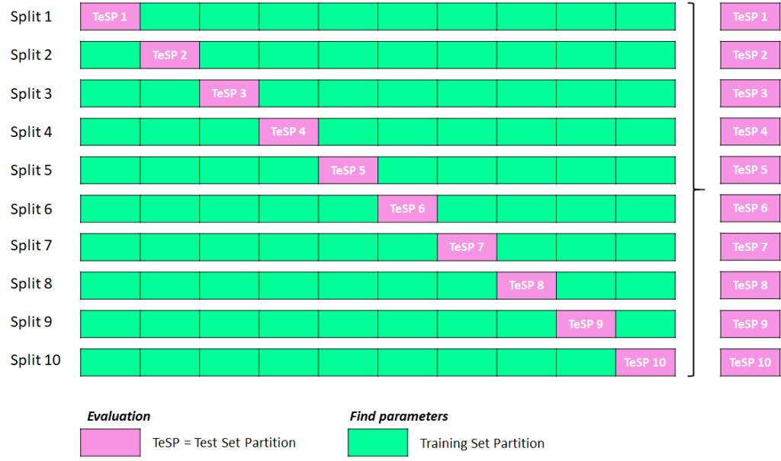
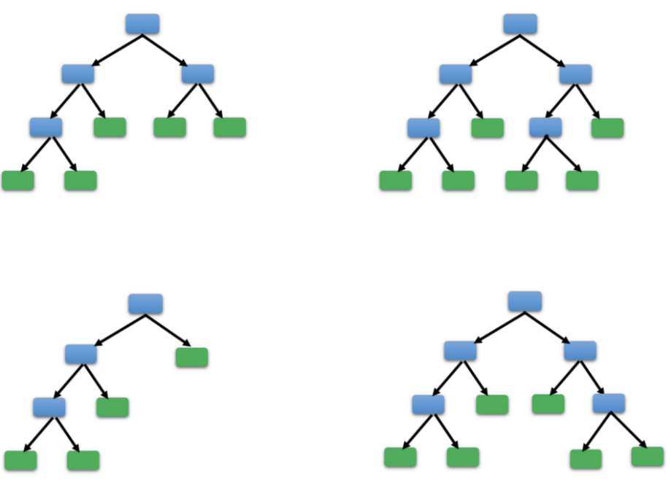
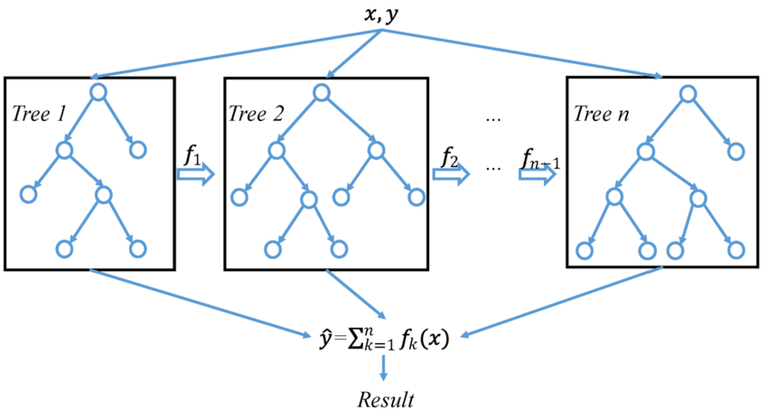
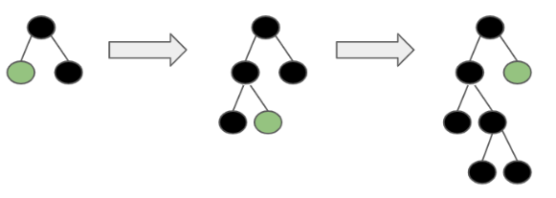
Cross Validation
10-fold Cross Validation
Linear regression;
k-nearest neighbors;
Random forest;
Xgboost;
Lightgbm.

Slide 11
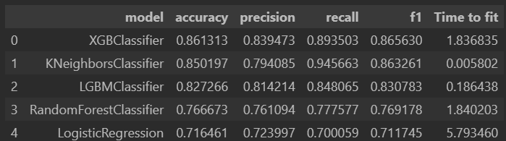
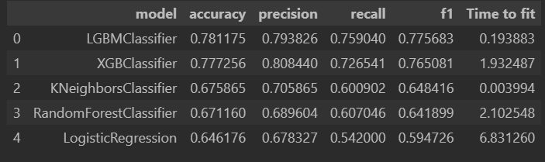
Cross Validation
Shuffled
Better results if shuffled
best model is the XGBClassifier
Best quality/effort is LGBM
Non-shuffled

Slide 12
Fitting the lightgbm model
Split the data
2013 to 2017 train set
2018 to 2020 test set
Use the lightgbm model to predict the target variable in the test set.
Compare the predictions with the actual values
We will also compute the evaluation metric.

Slide 13




ExplainerDashboard Deployement
LoadFiles.py
AWS EC2 instance
Copy file on AWS EC2 instance
Docker container
Upload files from github to AWS EC2 instance
DataFrame
Model
Docker files
Dashboard.py

Slide 14
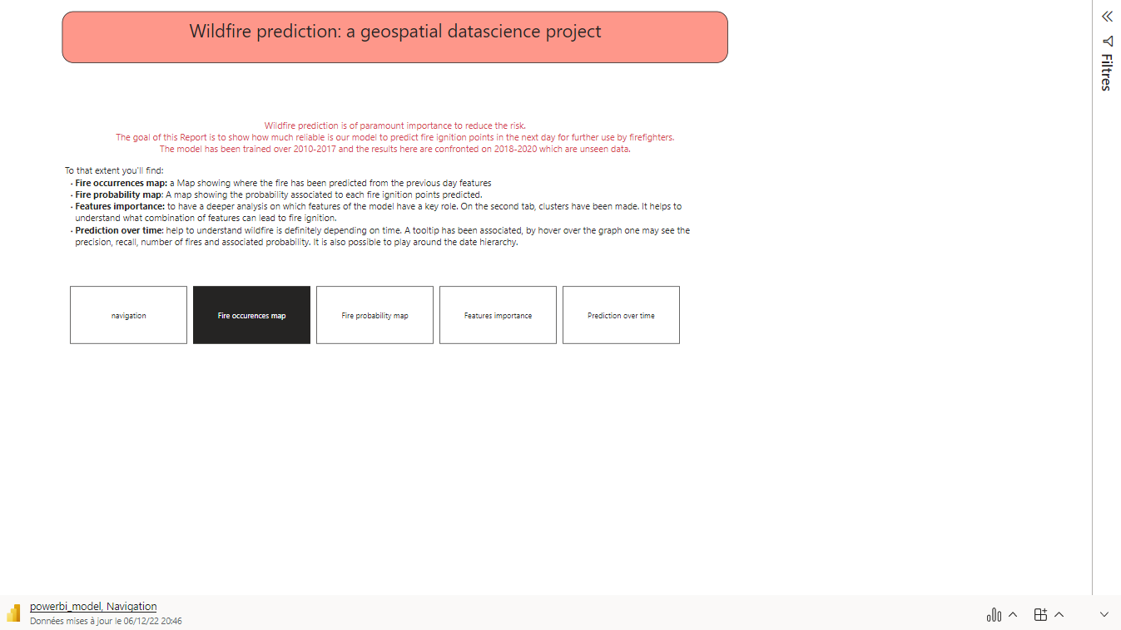

Slide 15
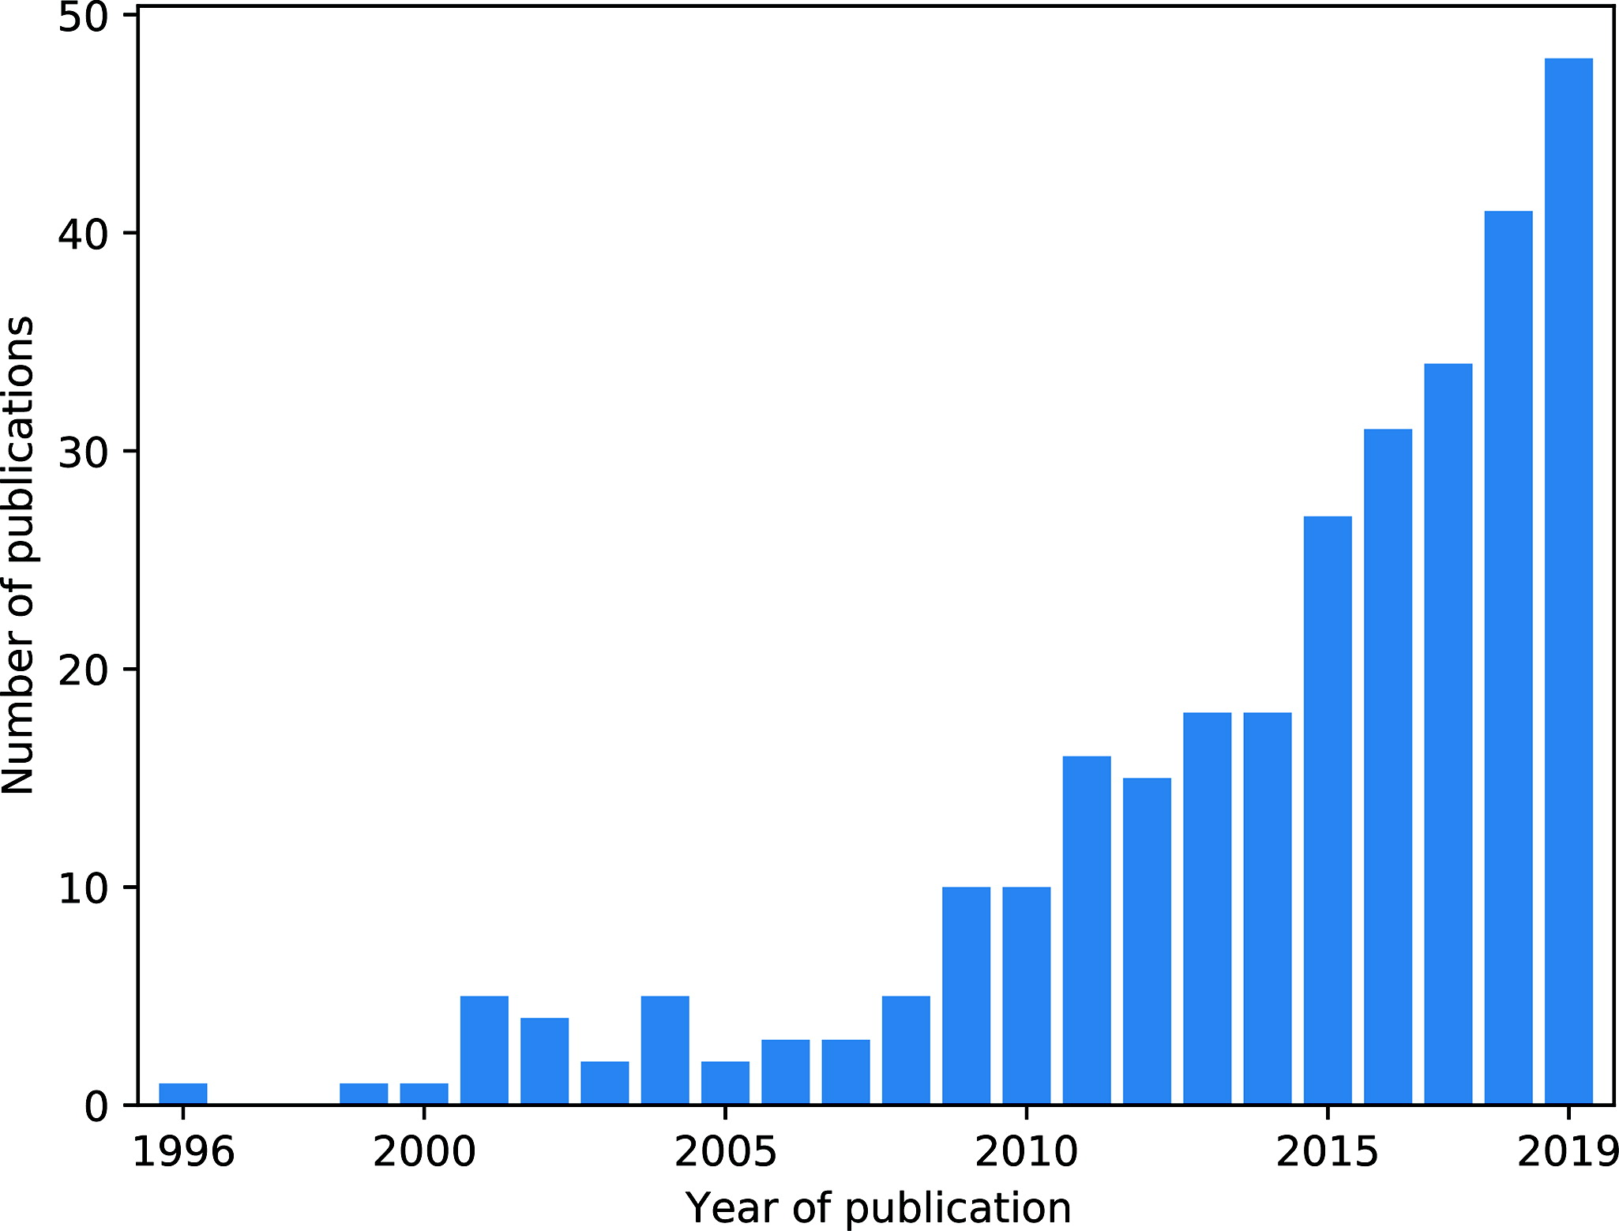

Literature reviews
300 publications by the end of 2019 on ML & wildfire science (Piyush Jain & al., 2020) .
127 are related to risk analysis (lightning impact, binary classifiers, heatmap…)
Exponential growth:
Computing power
Satellite data

Slide 16
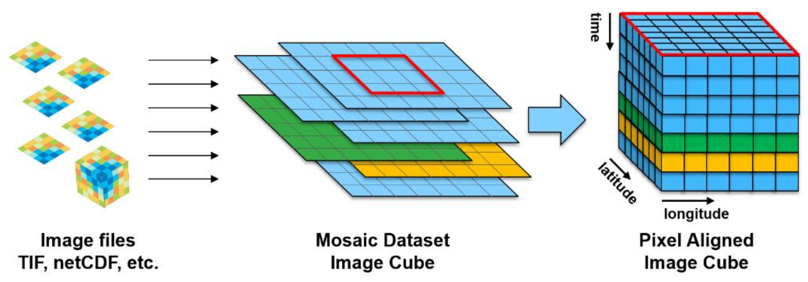
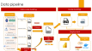

Data cube: define the size
It is just stacking/piling over time rasters!
SIZE
226,020,522 tiles
Latitude(182km) * longitude (309 km) = Area Of Interest
Time = 2010/01-2021/01 (4019 days) from Lit. review

Slide 17

Collect data
Data providers
10 datasets
Raw data
raster & vector
External provider
Vegetation (MOD13A2 v061)
Land surface temperature (MOD11A1)
Leaf Area Index (MOD15A2H v061)
Evapotranspiration (MOD16A2 v061)
Burn date (MCD64A1 v061)
Fire Mask (MYD14A2)
Remote sensoring data
CONCLUSION
10 datasets
27 layers (features)
3 files formats
EU vs USA std. : projection, time calendar…
resolution: 500m, 1km, 9 km
Different time granulometry: hrs, days, 8, days, month
Terra MODIS
External provider
Reanalysis data
Population density
Density dataset
External provider
Reanalysis data
Meteorological data (ERA5-Land)
Fire Weather index
Copernicus
External provider
Area Of Interest
Vector drawing
Personal drawing

Slide 18
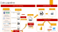
Datacube creation: python script flow
11 Create aggregated variables
Deleting duplicates attributes
Resampling to daily
Load the raw datasets
Select variables of interest
Select duration
Subset the time slice 2010-2021
Write CRS
Create CRS for sinusoidal projection, rotated pole and WGS84
Set the CRS for each dataset
Clipping
Define the Aoi
Clip to the AOI
Projection
Define a common grid
Project to the same CRS as the common grid
Project to the common grid
Create two lists
Merging
Fill the missing values
Harmonize the CF time convention to “Julian”
Subset the time slice 2010-2021
Match the coordinates
Rename the coordinates
Merge
Notes:
Snippet de code à ajouter

Slide 19
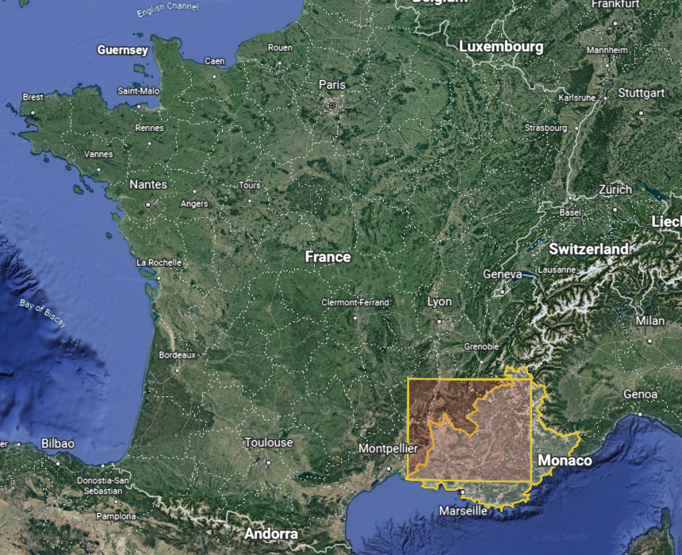

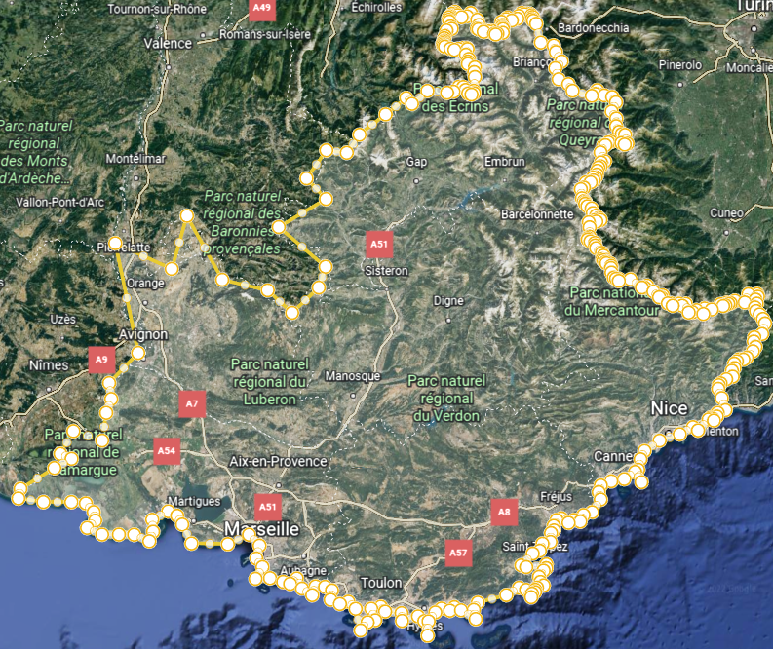
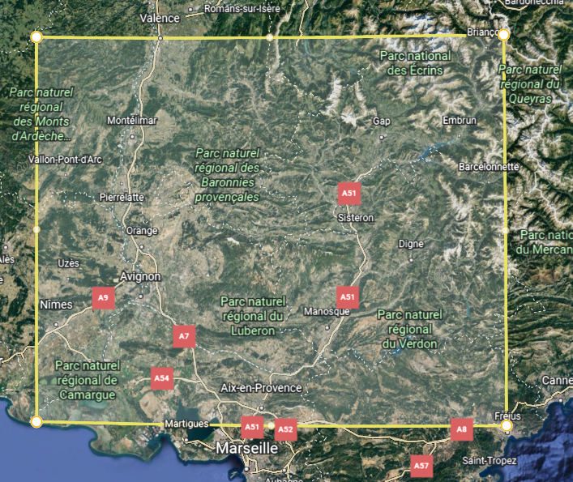


Defining the Area Of Interest
Initial AOI
Missing values
50%+ in MODIS
60%+ in ERA5
7%+ Na in MODIS
19% in ERA5
More edges → More Na

Slide 20
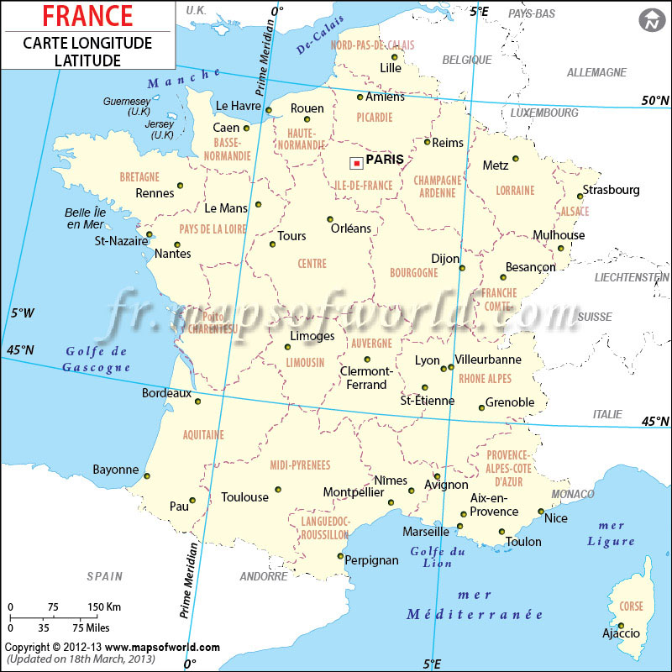

Defining the projection
Originally, we have data in:
Sinusoidal projection : MODIS products
WGS 84 (ndlr: GPS projection): ERA and Density
Rotated pole: FWI
We will keep the WGS84 (GPS) projectionfor two main reasons
Easier coordinate system to communicate
Better interoperability fir practical used case and integration

Slide 21
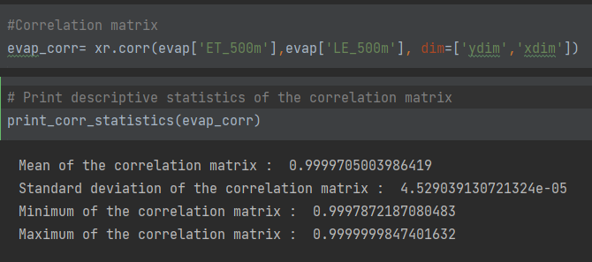

Features selection
High correlation between variables (same spatial location over time)
Interpretability:
Quality data in bit signed were not useful four our study in the latest MODIS product (reanalysis)
Here the evapotranspiration “ET_500m” and the latent heat “LE_500m” flux are strongly correlated

Slide 22
References
Piyush Jain piyush.jain@canada.ca, Sean C.P. Coogan, Sriram Ganapathi Subramanian, Mark Crowley, Steve Taylor, and Mike D. Flannigan, 2000. A review of machine learning applications in wildfire science and management
Nadeem K., Taylor S.W., Woolford D.G., and Dean C.B. 2020. Mesoscale spatiotemporal predictive models of daily human- and lightning-caused wildland fire occurrence in British Columbia. Int. J. Wildl. Fire, 29(1): 11–27.
Vega-Garcia C., Lee B.S., Woodard P.M., and Titus S.J. 1996. Applying neural network technology to human-caused wildfire occurrence prediction. AI Appl. 10: 9–18. Available from https://cfs.nrcan.gc.ca/publications?id=18949.
Goldarag Y.J., Mohammadzadeh A., and Ardakani A.S. 2016. Fire Risk Assessment Using Neural Network and Logistic Regression. J. Ind. Soc. Remote Sens. 44(6): 885–894.
Oliveira S., Oehler F., San-Miguel-Ayanz J., Camia A., and Pereira J.M. 2012. Modeling spatial patterns of fire occurrence in Mediterranean Europe using Multiple Regression and Random Forest. For. Ecol. Manage. 275: 117–129.
Fantine Huot1 , R. Lily Hu2 , Nita Goyal, Tharun Sankar, Matthias Ihme, and Yi-Fan Chen. 2022. Next Day Wildfire Spread: A Machine Learning Data Set to Predict Wildfire Spreading from Remote-Sensing Data. Available from https://arxiv.org/pdf/2112.02447.pdf
Ioannis Prapas1,2,*, Spyros Kondylatos1,2,*, Ioannis Papoutsis1 , Gustau Camps-Valls2 , Michele Ronco2 , Miguel-Ángel Fernández-Torres2 , Maria Piles Guillem2 , and Nuno Carvalhais3. 2021. Deep Learning Methods for Daily Wildfire Danger Forecasting. Available from https://arxiv.org/pdf/2111.02736.pdf

Slide 23
Reference
Causes
Data source
[1] Earth Data from NASA
[2] Ministère de lécologie et du développement durable
Era:
era 5
What is reanalisis

Slide 24
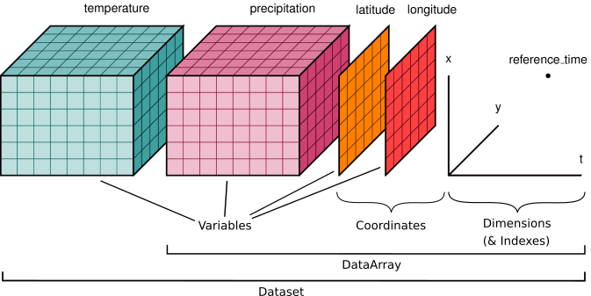
Manipulating

